Slide 1
Pessoas Ajudando Pessoas
“Nenhuma criança deixada atrás”
Jesse Anderson, Jonny Mills, Justin Snyder, Tianchu Ye

Slide 2
Business Case
High student failure rates
Recently, the early school leaving rate in Portugal was 40%
European Union average was just 15%
Failures are in critical core classes of Math and Portuguese

Slide 3
Our Scenario
Our model: using different factors such as parent’s job, study time, number of absences, romantic partner, etc. to predict student performance
Goal: identify failing students and provide additional assistance, tutoring.
Cost per student we estimate to be $1000 per kid for an entire year
Efficient use of capital is critical

Slide 4
Our Data
Real-world data in Math and Portuguese from two Portuguese secondary schools
Mark reports and questionnaires were used to compile the data
1044 observations, each observation being a student’s demographics and final grade

Slide 5
Data Preprocessing
1 row with NA, removed
Most variables are categorical, hard to scale/center
Converted age and number of absences to numeric
Converted character variables to factors
Removed 2nd semester grade
Split the data
Train : Test = 80 : 20

Slide 6
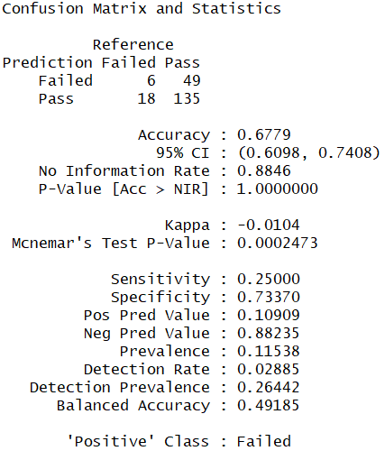
Best Model without G1
Tree bagging model
Low accuracy 67.8%
Only correctly predicted 6 out of 55 failing students
Giving extra help to 18 students who don’t need it

Slide 7
Our Models
Boosting
Tree Bagging
Random Forest
DISHONORABLE MENTION:
SVM
Notes:
Caret package, 10- fold cross validation; SVM predicting everyone to pass the semester

Slide 8
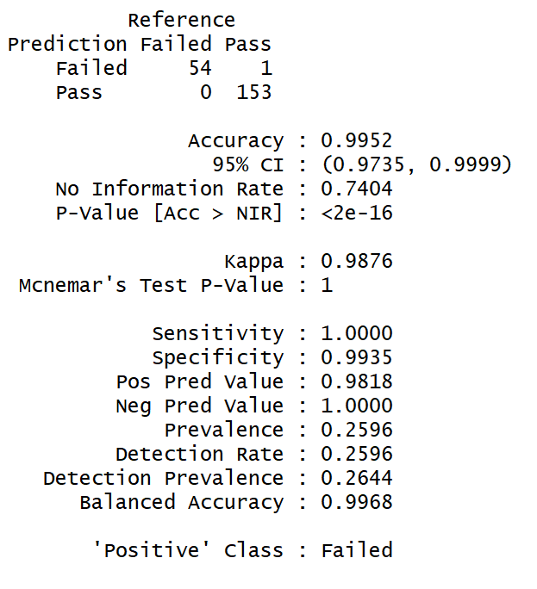
Model- Boosting
99.52% accuracy
Only one student “left behind” in this case

Slide 9
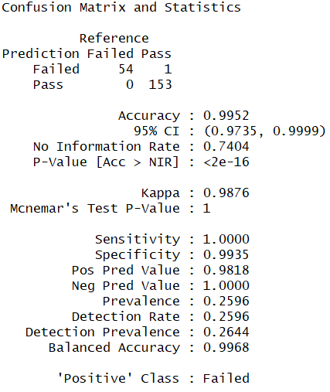
Model- Tree bagging
99.52% accuracy
Identical results to Boosting

Slide 10
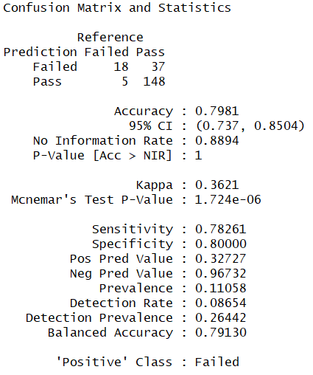
Model- Random Forest
79.81% accuracy
High Type I error, 37 students left behind
Low Type II error (0.0184)

Slide 11
Comparing Models
 | Boosting | Tree Bagging | Random Forest
Error Rate | 0.0048 | 0.0048 | 0.2153
Type I Error | 0.018 | 0.018 | 0.9130
Type II Error | 0 | 0 | 0.0184

Slide 12
Conclusion
Come in after first period
Identifying >99% all the failing students
High accuracy: Cost efficient model
Ideally get the failure rates near the EU average
Passing core class allowing long term success for these students

Slide 13
Backup Slides

Slide 14
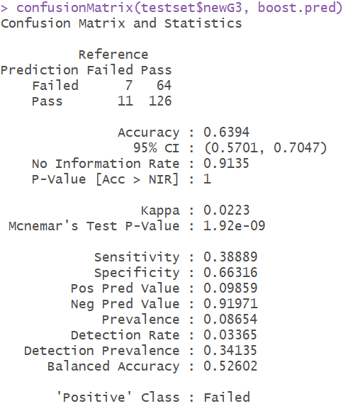
Model- Boosting
Stochastic gradient boosting in caret (“gbm”)
fitControl is built on 10-fold cross validation
Overall error rate is good, but the type I error is very high.

Slide 15
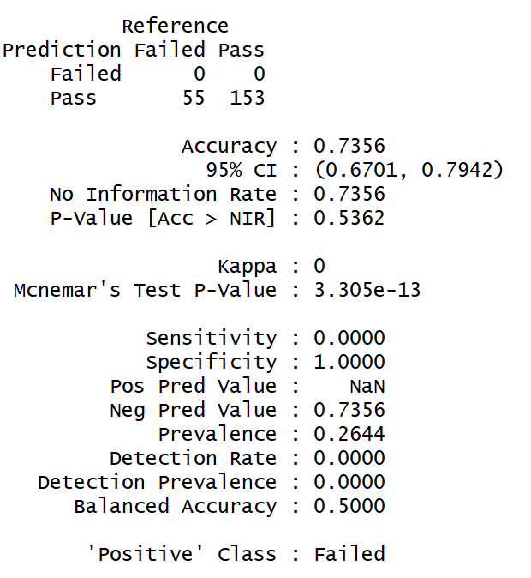
Model- SVM
Ran linear and radial SVMs
Bust!
Notes:
Type 1 error: specificity
Type 2 error: sensitivety.

Slide 16
Data Citation
P. Cortez and A. Silva. Using Data Mining to Predict Secondary School Student Performance. In A. Brito and J. Teixeira Eds., Proceedings of 5th FUture BUsiness TEChnology Conference (FUBUTEC 2008) pp. 5-12, Porto, Portugal, April, 2008, EUROSIS, ISBN 978-9077381-39-7.

